Slide 1
Introduction to Machine Learning
Parinya Sanguansat

Slide 2
Course details
Subject: Machine Learning
Lecturer: Assoc. Prof. Parinya Sanguansat, Ph.D.
Email: parinyasan@pim.ac.th
Material:
Python

Slide 3
Scoring

Slide 4
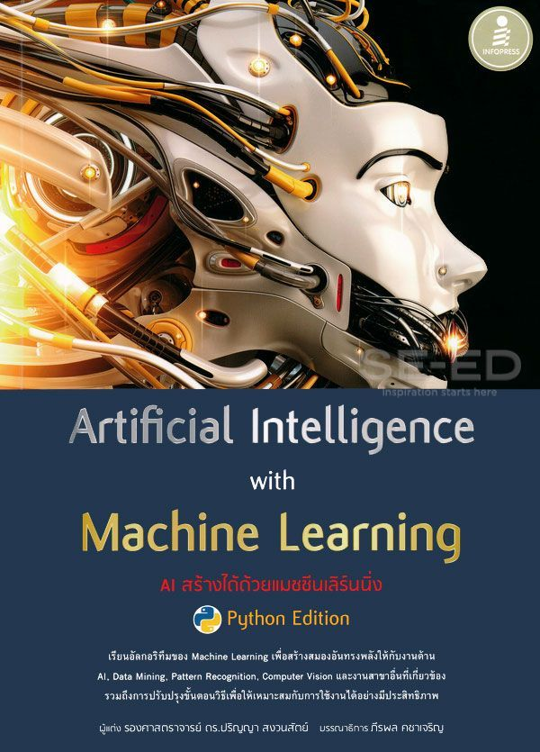
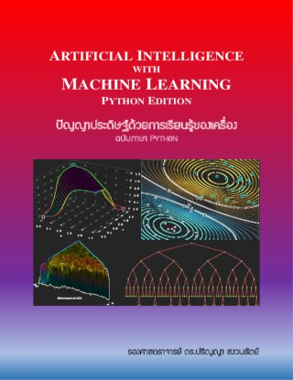
Reference Books

Slide 5
What is Machine Learning?
Informal definition: Any computer program that improves its performance at some task through experience and/or data
Formal Definition: A computer program is said to learn from experience E with respect to some class of tasks T and performance measure P, if its performance at tasks in T, as measured by P, improves with experience E.

Slide 6
Why use Machine Learning?
Easier for us
Program one learning algorithm & let computer do all the work
Means we don’t have to know about the problem since algorithm can learn the relevant detail
Better Performance
We have biases which affect our judgment

Slide 7
When to use Machine Learning?
When we don’t know much about the problem
When we have a lot of empirical data
When we are lazy!

Slide 8
Applications of Machine Learning
Machine perception
Computer vision
Natural language processing
Syntactic pattern recognition
Search engines
Medical diagnosis
Bioinformatics
Brain-machine interfaces and cheminformatics
Detecting credit card fraud
Stock market analysis
Classifying DNA sequences
Speech and handwriting recognition
Object recognition in computer vision
Game playing
Software engineering and robot locomotion

Slide 9
Well Posed Learning Problems
Learning:
improving with experience at some task
Improve over task T
With respect to performance measure P
Based on experience E

Slide 10
Well Posed Learning Problems
A handwriting recognition learning problem
T: recognizing and classifying handwritten words within images
P: percent of words correctly classified
E: a database of handwritten words with given classifications
A robot driving learning problem
T: driving on public motorways using vision sensors
P: average distance travelled before an error (as judged by human overseer)
E: a sequence of images and steering commands recorded while observing a human driver

Slide 11
Learning to play checkers
Learning to Play Checkers
T: play games of checkers
P: percent of games won in world tournament
E: opportunity to play against self
Refining the Problem Specification: Issues
What experience?
What exactly should be learned?
How shall it be represented?
What specific algorithm to learn it?

Slide 12
Designing a Learning System
Goal: Design a system to learn how to play checkers and enter it into the world checkers tournament.
Choose the training experience
Choose the target function
Choose a representation for the target function
Choose a function approximation algorithm

Slide 13
Choose the training experience
Direct or indirect?
Direct: board state -> correct move
Indirect: outcome of a complete game
Teacher or not ?
Teacher selects board states
Learner can select board states
Is training experience representative of performance goal?
Training playing against itself
Performance evaluated playing against world champion

Slide 14
Direct or indirect?
Direct
B4→A3

Slide 15
Direct or indirect?
Indirect
Blue wins

Slide 16
Choose the target function
ChooseMove : B → M : board state → move
Maps a legal board state to a legal move
Evaluate : B → R : board state → board value
Assigns a numerical score to any given board state, such that better board states obtain a higher score
Select the best move by evaluating all successor states of legal moves and pick the one with the maximal score

Slide 17
ChooseMove or Evalute?
ChooseMove: board state → move
B4→A3

Slide 18
ChooseMove or Evalute?
Evalute: board state → board value
20

Slide 19
Define the target function
If we play blue
If b is a final board state that is won then V(b) = -100
If b is a final board state that is lost then V(b) = 100
If b is a final board state that is drawn then V(b)=0
If b is not a final board state, then V(b)=V(b’), where b’ is the best final board state that can be achieved starting from b and playing optimally until the end of the game.

Slide 20
Final Board States
Blue wins: V(b)=-100

Slide 21
Final Board States
Red wins: V(b)=100

Slide 22
Final Board States
Draw: V(b)=0

Slide 23
Choose a representation for the target function
Table look-up
Collection of rules
Neural networks
Polynomial function
etc.
trade-off in choosing an expressive representation:
approximation accuracy
number of training examples required to learn the target function

Slide 24
Representation of Target Function
Polynomial function
Degree 1 → Linear function
V(b) = w₀ + w₁rp(b) + w₂bp(b)
bp(b): #blue pieces
rp(b): #red pieces
V(b) : true target function
V’(b) : learned target function (hypothesis)
Vtrain(b) : training value
Rule for estimating training values:
Vtrain(b) ← V’(Successor(b))

Slide 25
Choose a function approximation algorithm
Least Mean Square (LMS) weight update rule:
Select a training example b at random
1. Compute error(b)
error(b) = Vtrain(b) – V’(b)
= V’(Successor(b )) – V’(b)
2. For each board feature f_{i}, update weight
w_{i} ← w_{i} + η f_{i} error(b)
η : learning rate approx. 0.1

Slide 26
Summary
Goal: Design a system to learn how to play checkers and enter it into the world checkers tournament.
Choose the training experience
Indirect
Choose the target function
Evalute
Choose a representation for the target function
Polynomial function (linear)
V(b) = w₀ + w₁rp(b) + w₂bp(b)
Choose a function approximation algorithm
LMS

Slide 27
Learning
Initial weights: w₀=-10, w₁ =75, w₂ =-60
V’(b₀) = w₀+w₁*2+w₂*2 = 20
V’(b₁) = 20
V’(b₁) = 20
V’(b₁) = 20

Slide 28
Learning
V’(b₀) = 20
V’(b₁) = 20
error(b₀) = V’(b₁) - V’(b₀) = 0
Update weights
w₀ ← w₀ + 0.1 * 1 * 0
w₁ ← w₁ + 0.1 * 2 * 0
w₂ ← w₂ + 0.1 * 2 * 0

Slide 29
Learning
V’(b₀) = 20
V’(b₁) = 20
V’(b₃) = 20
V’(b₂) = 20

Slide 30
Learning
V’(b₃) = 20
V’(b₄) = 20
V’(b₄) = -55

Slide 31
Learning
V’(b₃) = 20
V’(b₄) = -55
error(b₃) = V’(b₄) - V’(b₃) = -75
Update weights (w₀=-10, w₁ =75, w₂ =-60)
w₀ ← w₀ + 0.1 * 1 * -75 = -17.5
w₁ ← w₁ + 0.1 * 2 * -75 = 60
w₂ ← w₂ + 0.1 * 2 * -75 = -75

Slide 32
Learning
V’(b₄) = -107.5
V’(b₅) = -107.5
V’(b₆) = -167.5
error(b₅) = V’(b₆) - V’(b₅) = -60
Update weights (w₀= -17.5, w₁ = 60, w₂ =-75)
w₀ ← w₀ + 0.1 * 1 * -60 = -23.5
w₁ ← w₁ + 0.1 * 1 * -60 = 54
w₂ ← w₂ + 0.1 * 2 * -60 = -87

Slide 33
Learning
Final board state: blue won V(b)=-100
V’(b₆) = -197.5
error(b₆) = V(b) - V’(b₆) = 97.5
Update weights (w₀= - 23.5, w₁ = 54, w₂ = -87)
w₀ ← w₀ + 0.1 * 1 * 97.5 = –13.75
w₁ ← w₁ + 0.1 * 0 * 97.5 = 54
w₂ ← w₂ + 0.1 * 2 * 97.5 = -67.5

Slide 34
Testing
Play blue
Red first
For all legal moves:
simulate that move
check the value of the result
Pick the best move

Slide 35
Class work 1:Tic-Tae-Toe
Determine the target function for playing Tic-Tae-Toe and never lose
X | O | X
O | X
 | X | O

